Slide 1
Issue List
2015 05 21

Slide 2
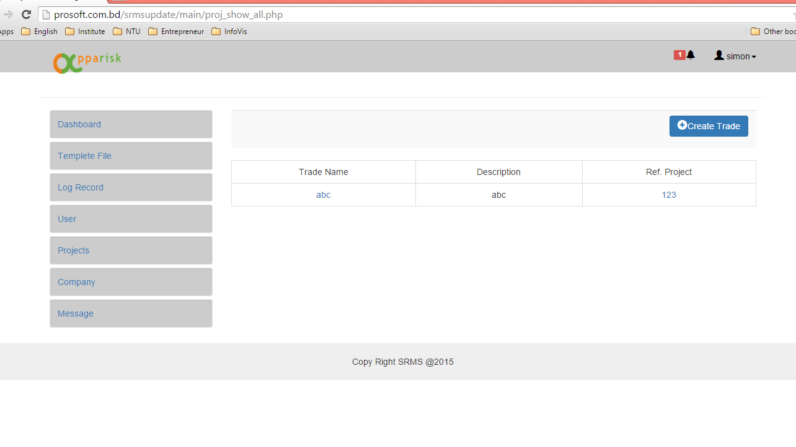
1
3
2
4
5
6
1
1. Take out the unnecessary button
and reorder accordingly.
The active button should
have different color.
3. Take out this line
4. Take out this background color
5. Change “trade” text to “project”
2. Change “trade” text to “project”
6. The difference between
table header and table body
should have.
Please take out the border right
and left

Slide 3
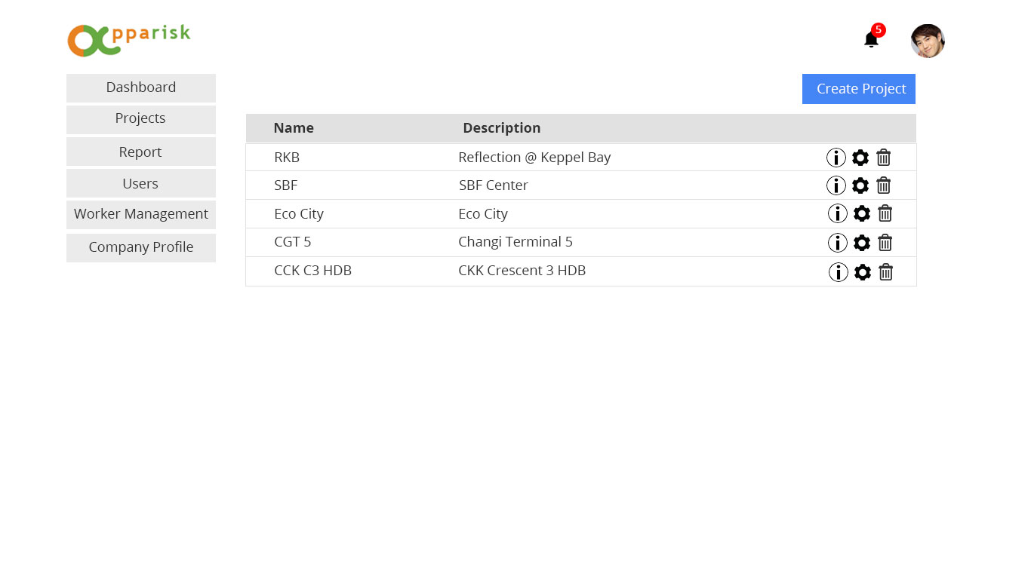
Purposed idea

Slide 4
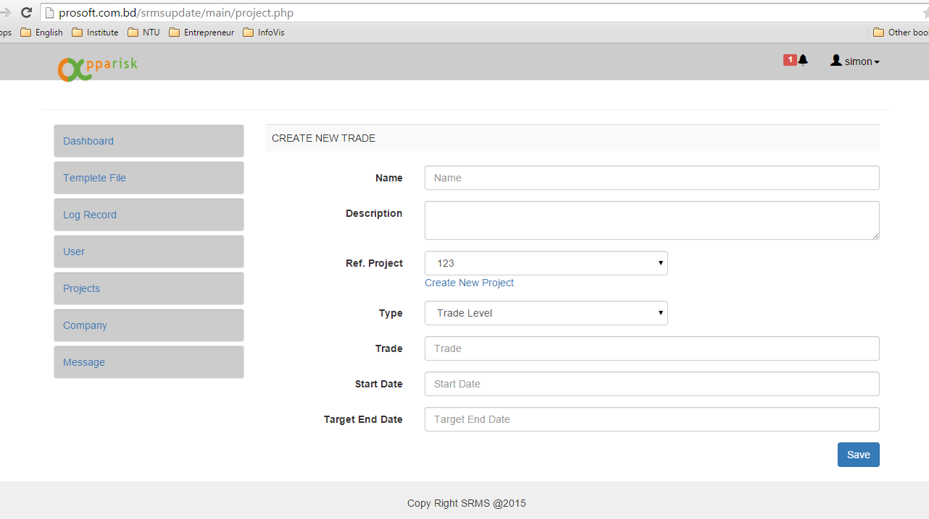
2
3
2
4
1
5
1, 2, 3, 4 are same as previous
5. Take out type and trade

Slide 5
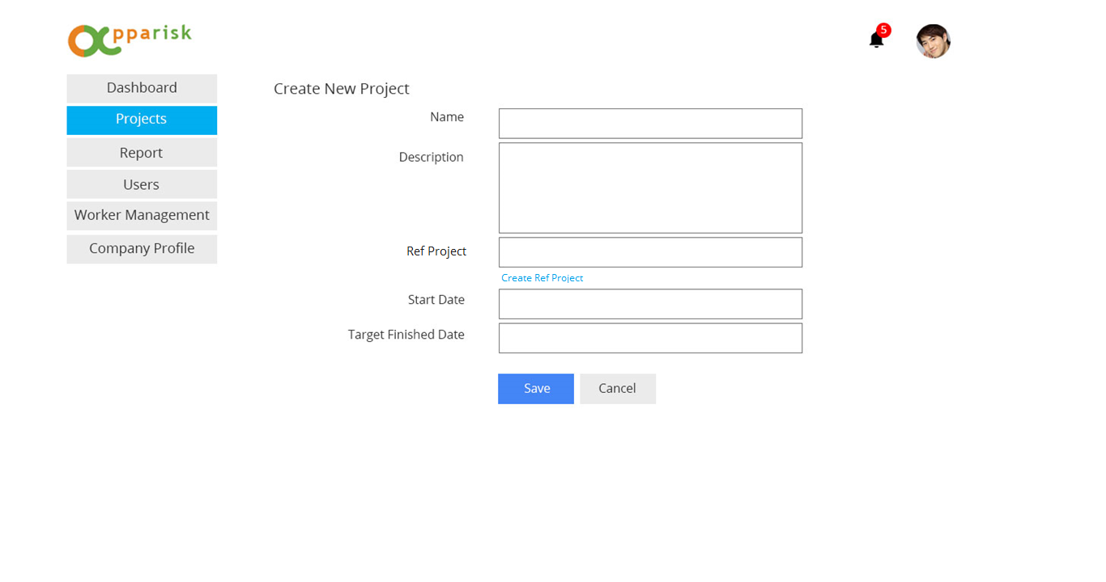
Purposed idea

Slide 6
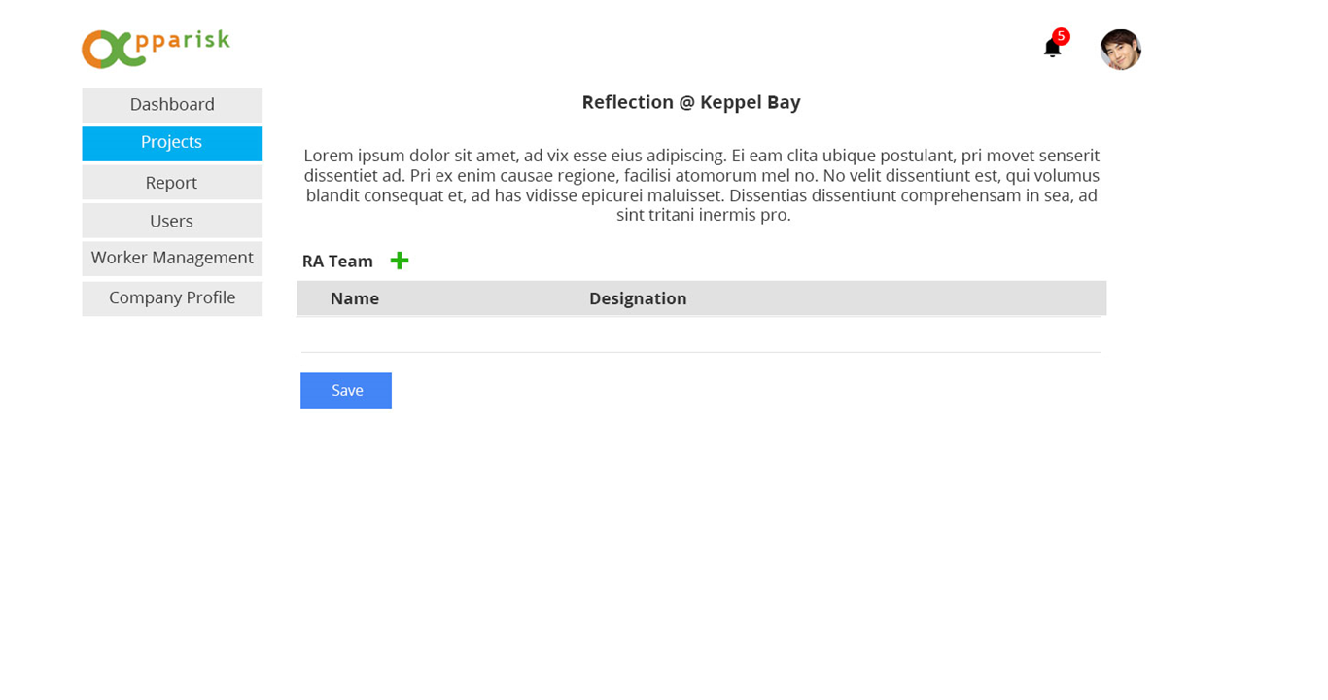
Extra step after create project

Slide 7
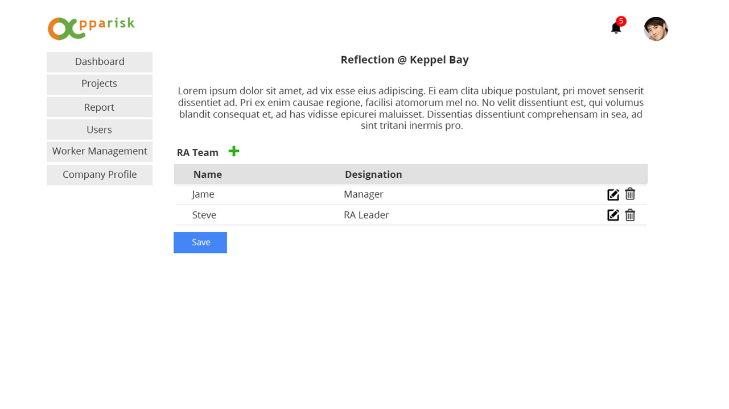
Extra step after create project

Slide 8
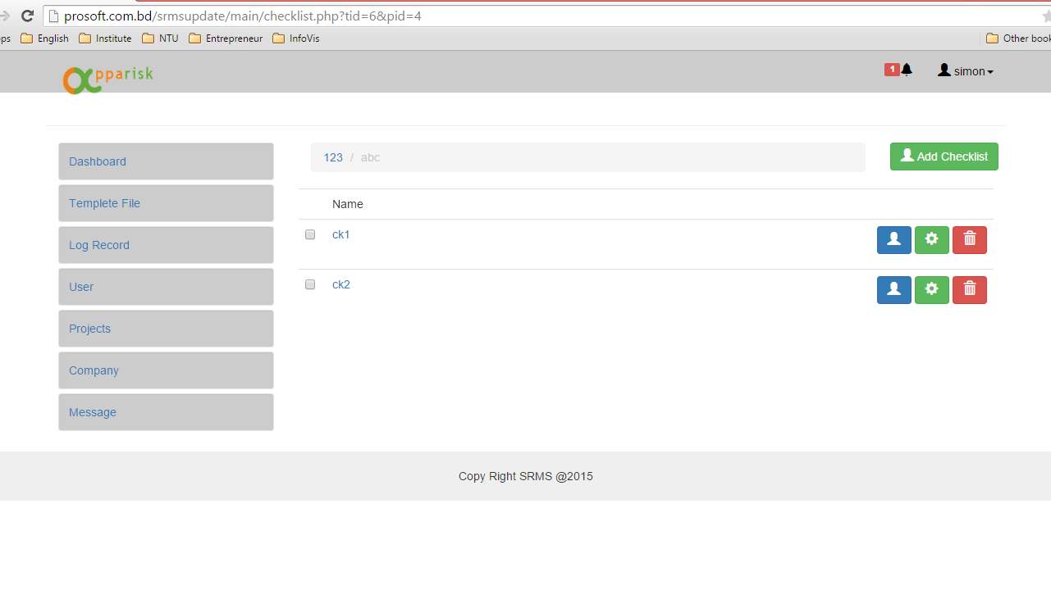
3
3
4
2
5
6
1
5. If we don’t have batch deletion
and assignment, we should not
include checkbox
1, 3, 4 are same as previous
6. Different color for different function is
good but it destroy the overall design
appeal
2. Button and icon are not match.
and button color is not consistent

Slide 9
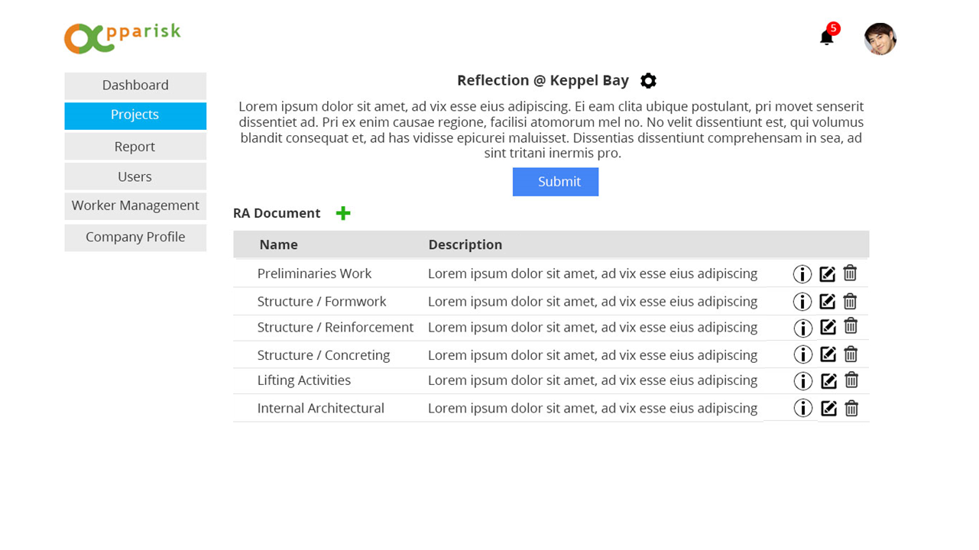
Purposed idea

Slide 10
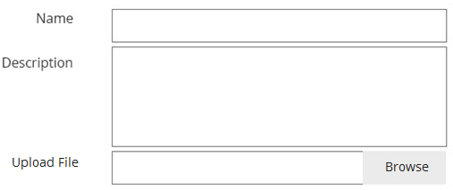

Purposed idea

Slide 11
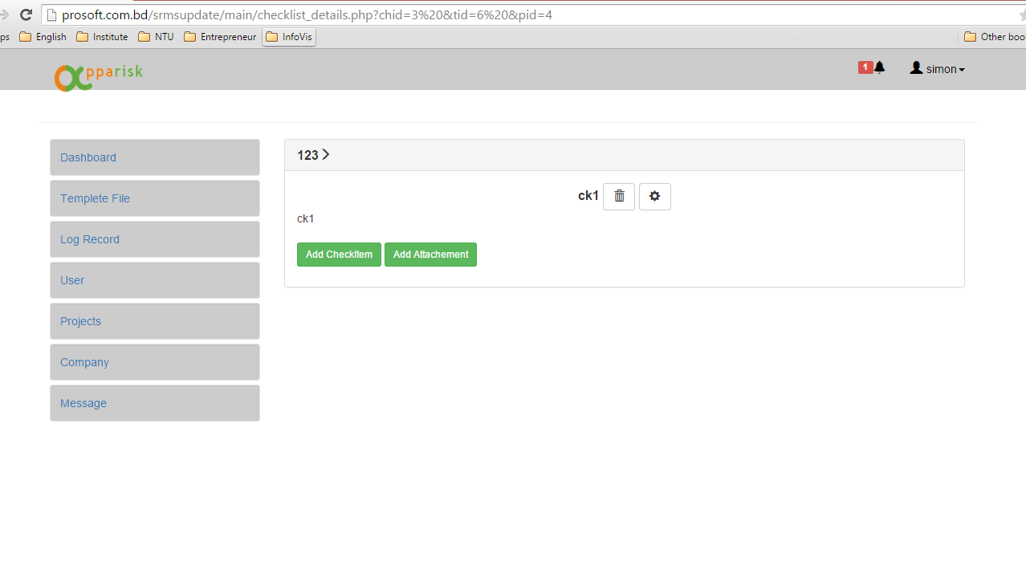
4
I want to highlight something here is design inconsistency.
Please look at Page 1 to page 4, we are showing the similar content. But the look and feel is different from each other.
For example, we all buy IPad and paid the same price. We got IPad with different performance for each. How do we feel?
I understand everything can be done easily but my thought is why we cannot do that before other people found out.

Slide 12
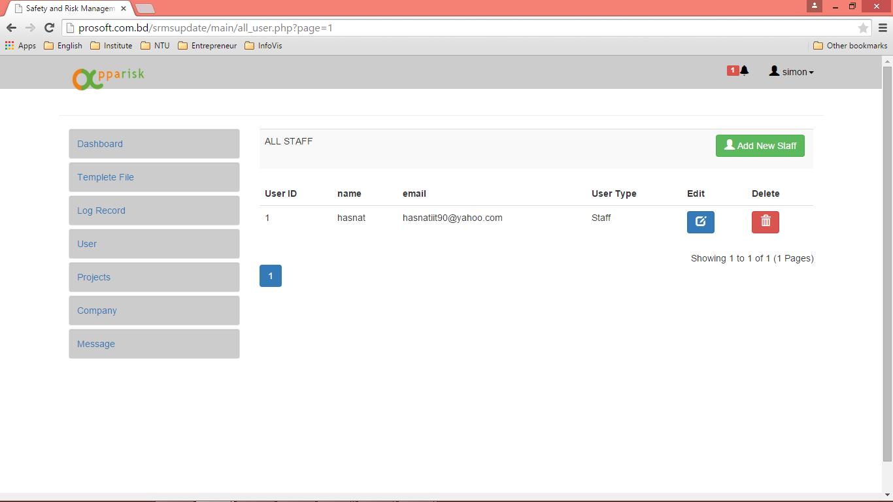
Should we show the user id?

Slide 13
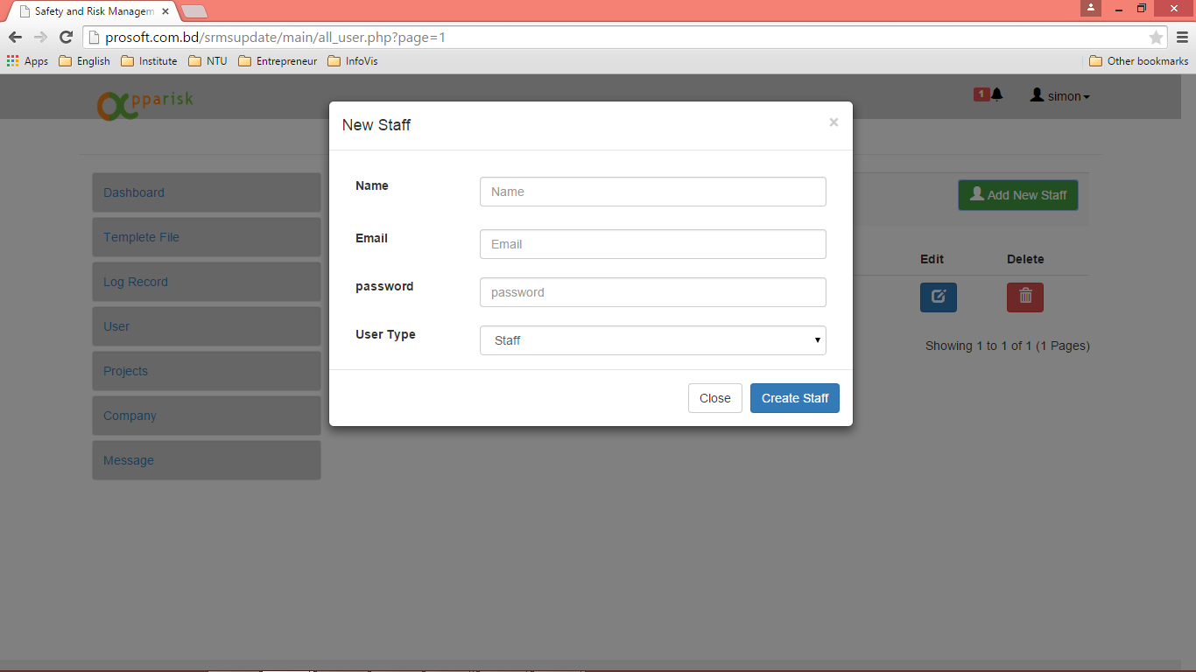
1
3
2
1, 2 are same function, do we need two.
3. We no need the user type for this phase.
And order of the button.
If we will put the save button right and close button left, we should arrange all the button like that way.

Slide 14
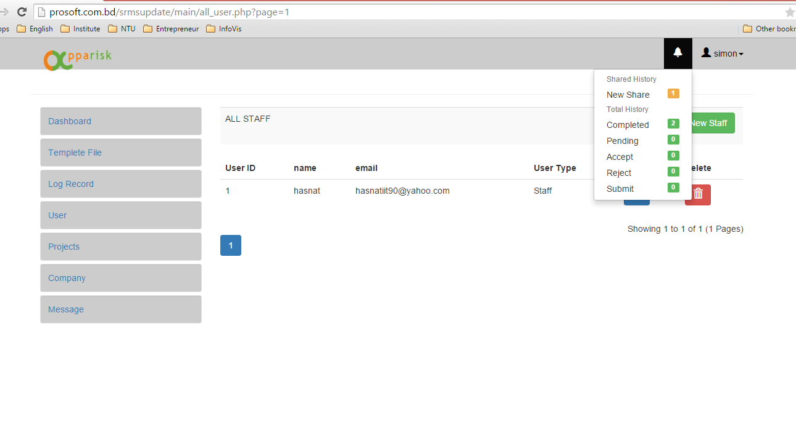
Take out all broken link and button that have no action.

